Slide 1
Birefringence
Outline
Polarized Light (Linear & Circular)
Birefringent Materials
Quarter-Wave Plate & Half-Wave Plate
Reading: Ch 8.5 in Kong and Shen

Slide 2
True / False
1. The plasma frequency is the frequency above which a material becomes a plasma.
The magnitude of the -field of this wave is 1
3. The wave above is polarized 45º with respect to the x-axis.

Slide 3
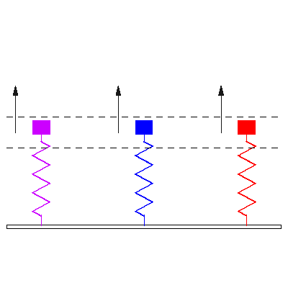
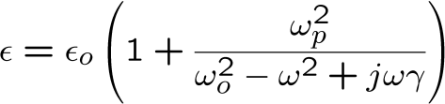

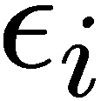

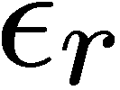

Microscopic Lorentz Oscillator Model

Slide 4
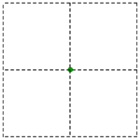
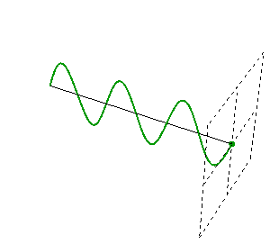

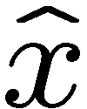

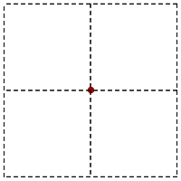
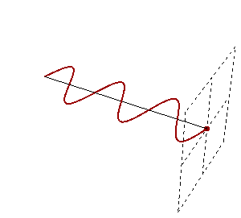
Sinusoidal Uniform Plane Waves

Slide 5
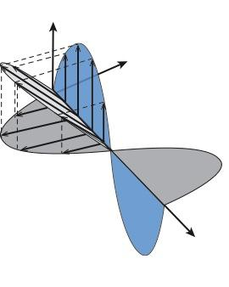
45° Polarization
The complex amplitude,
,is the same for both components.
Therefore and are always in phase.
Where is the magnetic field?

Slide 6
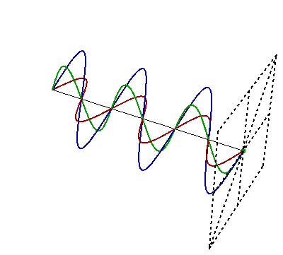
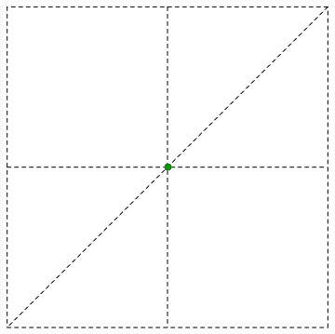
Superposition of Sinusoidal Uniform Plane Waves
Can it only be at 45º ?

Slide 7
Arbitrary-Angle Linear Polarization
E-field variation over time
(and space)
y
Here, the y-component is in phase
with the x-component,
but has different magnitude.
x

Slide 8

Arbitrary-Angle Linear Polarization
Specifically:
0° linear (x) polarization:
90° linear (y) polarization:
45° linear polarization:
Arbitrary linear polarization:

Slide 9
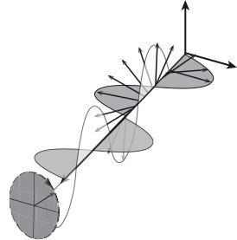
Circular (or Helical) Polarization
… or, more generally,
The complex amplitude of the x-component is -j times the complex amplitude of the
y-component.
E_{x} and E_{y} are always
90 ͦ out of phase
The resulting E-field rotates
counterclockwise around the
propagation-vector
(looking along z-axis).
If projected on a constant z plane the
E-field vector would rotate clockwise !!!

Slide 10

Right vs. Left Circular (or Helical) Polarization
E-field variation over time
(at z = 0)
… or, more generally,
Here, the complex amplitude
of the x-component is +j times
the complex amplitude of the
y-component.
So the components are always
90 ͦ out of phase, but in the other direction
The resulting E-field rotates
clockwise around the
propagation-vector
(looking along z-axis).
If projected on a constant z plane the E-field vector would rotate counterclockwise !!!

Slide 11


Unequal arbitrary-relative-phase components yield elliptical polarization
E-field variation over time
(and space)
where
… or, more generally,
The resulting E-field can rotate clockwise or counter-clockwise around the k-vector (looking along k).
… where are arbitrary
complex amplitudes

Slide 12
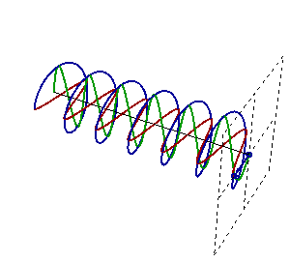
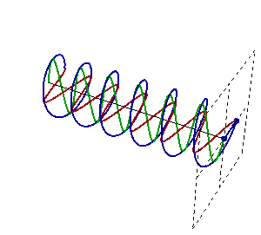
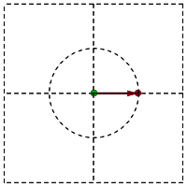


Sinusoidal Uniform Plane Waves
Left
IEEE Definitions:
Right
Notes:
12

Slide 13
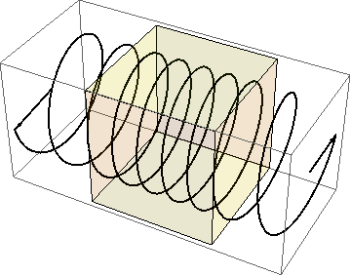
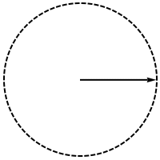
A linearly polarized wave can be represented as a sum of two circularly polarized waves

Slide 14
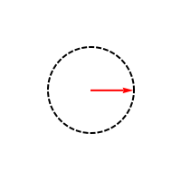
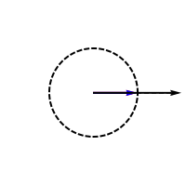
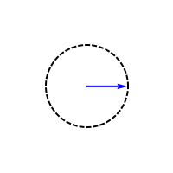
A linearly polarized wave can be represented as a sum of two circularly polarized waves
CIRCULAR
LINEAR
CIRCULAR

Slide 15
Polarizers for Linear and Circular Polarizations
CASE 1:
Linearly polarized light with magnitude oriented 45º with respect to the x-axis.
CASE 2:
Circularly polarized light with magnitude .
Wire grid polarizer
What is the average power at the input and output?
Notes:
Shouldn’t the the answer for case 2 also be s_out=E0^2/(4eta)

Slide 16
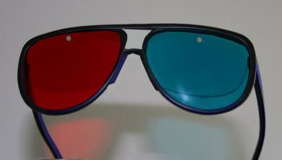
Today’s Culture Moment
3D
Image is in the public domain.
vision

Slide 17

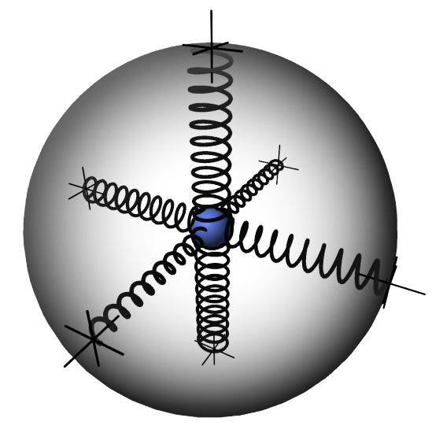





Anisotropic Material
The molecular
"spring constant" can be different for different directions
If ,
then the material has a single optics axis and is called
uniaxial crystal

Slide 18


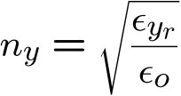
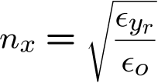
Microscopic Lorentz Oscillator Model
In the transparent regime
…

Slide 19

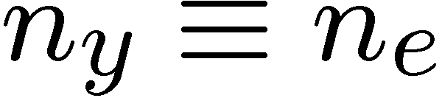
Uniaxial Crystal
Optic
axis
Uniaxial crystals have one refractive index for light
polarized along the optic axis (n_{e})
and another for light polarized in either of the two directions perpendicular to it (n_{o}).
Light polarized along the optic axis is called the extraordinary ray,
and light polarized perpendicular to it is called the ordinary ray.
These polarization directions are the crystal principal axes.
Extraordinarypolarizations
Ordinary polarizations
Ordinary…
Extraordinary…

Slide 20
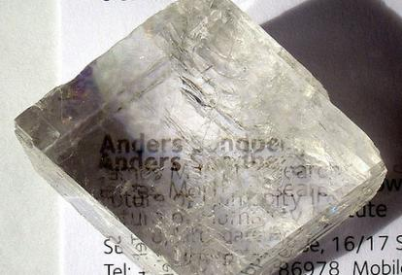
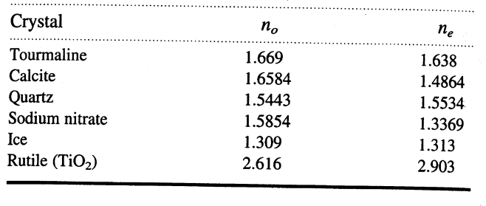
Birefringent Materials
o-ray
n_{o}
e-ray
n_{e}
Image by Arenamotanus http://www.flickr.com/photos/
arenamontanus/2756010517/ on flickr
All transparent crystals with non-cubic lattice structure are birefringent.

Slide 21
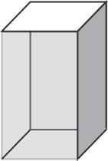




Polarization Conversion
Linear to Circular
inside
Polarization of output wave is determined by…

Slide 22

Quarter-Wave Plate
Circularly polarized output
left circular
output
45º
fast axis
linearly polarized input
Example:
If we are to make quarter-wave plate using calcite (n_{o} = 1.6584, n_{e} = 1.4864), for incident light wavelength of = 590 nm, how thick would the plate be ?
d_{calcite QWP} =
(590nm/4) / (n_{o}-n_{e}) = 858 nm

Slide 23

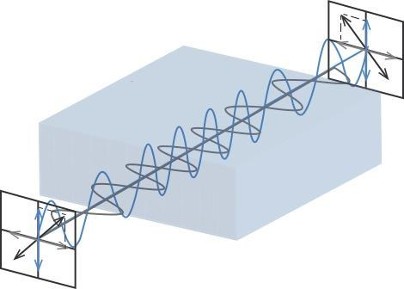
Half-Wave Plate
The phase difference between the waves linearly polarized parallel and perpendicular to the optic axis is a half cycle
Optic
axis
45º
LINEAR IN → LINEAR OUT

Slide 24
EM Waves can be linearly, circularly, or elliptically polarized.
A circularly polarized wave can be represented as a sum of two linearly polarized waves having phase shift.
A linearly polarized wave can be represented as a sum of two circularly polarized waves.
In the general case, waves are elliptically polarized.
Key Takeaways
Circular Polarization
Waveplates can be made from birefringent materials:
Quarter wave plate: (gives phase shift)
Half wave plate: (gives phase shift)

Slide 25
MIT OpenCourseWare
http://ocw.mit.edu
6.007 Electromagnetic Energy: From Motors to Lasers
Spring 2011
For information about citing these materials or our Terms of Use, visit: http://ocw.mit.edu/terms.

