Slide 1
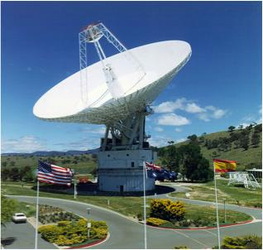
Generating
Electromagnetic Waves
Parabolic antenna for communicating with spacecraft, Canberra, Australia
Image is in the public domain.
Outline
Uniform Plane Waves
Energy Transported by EM Waves (Poynting Vector)
Current Sheet & Quasi-static Approximation
Transient Analysis for Current Sheet Antenna

Slide 2
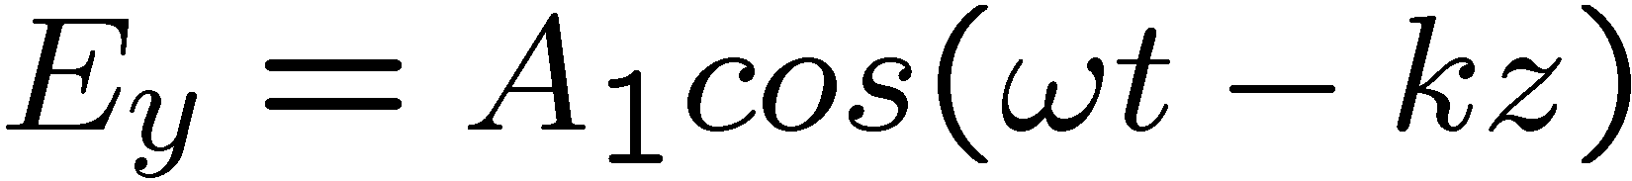
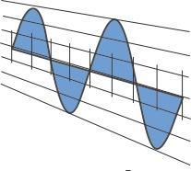



Uniform Plane Wave
100,000 km per div
1 V/m per div
Estimate the wavevector k?
Estimate the angular frequency ?
Estimate the magnitude of the electric field.
Estimate the magnitude of the magnetic field.

Slide 3

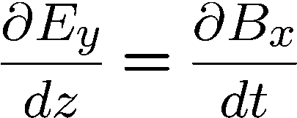
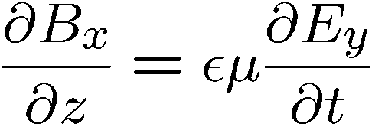
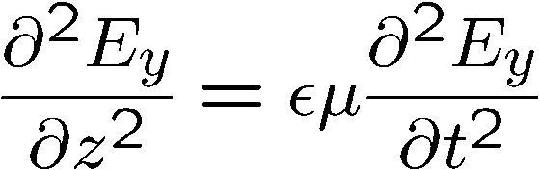
Coupling of Electric and Magnetic Fields
Maxwell’s Equations couple H and E fields…
Source free
The Wave Equation

Slide 4


Electromagnetic Energy Storage
Recall …
Magnetic
Electric
Magnetic machine
Electric machine

Slide 5


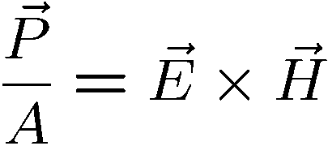

Power Flow of a Uniform Plane Wave
Poynting Vector

Slide 6
Euler’s Formula
This gives us the famous identity known as Euler’s formula:
From this, we get two more formulas:
Exponential functions are often easier to work with than sinusoids, so these formulas can be useful.
The following property of exponentials is still valid for complex z:
Using the formulas on this page, we can prove many common trigonometric identities. Proofs are presented in the text.

Slide 7
Modern Version of Steinmetz’ Analysis
Begin with a time-dependent analysis problem posed in terms of real variables.
Replace the real variables with variables written in terms of complex exponentials; is an eigenfunction of linear time-invariant systems.
Solve the analysis problem in terms of complex exponentials.
Recover the real solution from the results of the complex analysis.

Slide 8
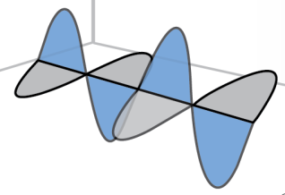
How Are Uniform EM Plane Waves Launched?
Generally speaking, electromagnetic waves are launched by
time-varying charge distributions and currents.
Man-made systems that launch waves are often called antennas.
Uniform plane waves are launched by current sheets.
K

Slide 9

Static Magnetic Field from Current Sheet
uniform DC surface current
What is the -field?

Slide 10
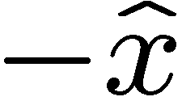
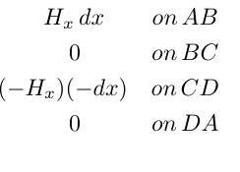
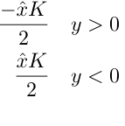
Magnetic Field Above/Below a Sheet of Current
… flowing in the direction with current density
uniform DC surface current
As seen “end on”, the current sheet may be thought of as a combination of parallel wires, each of which produces its own field. These fields combine, so that the total field above and below the current sheet is directed in and direction, respectively.
In between the wires
the fields cancel

Slide 11
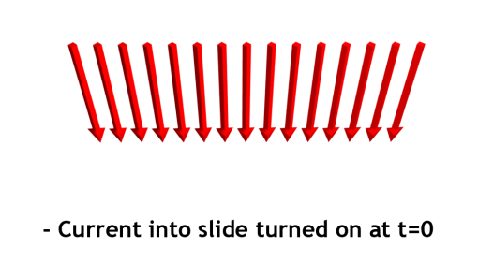


Transient Magnetic Field from Current Sheet
Turn on current (red) at
For now lets note that can’t propagate further than distance away from the current sheet in time
Don’t worry about
the shape of yet.
Which way does point ?

Slide 12


Time-Varying Magnetic Field from Current Sheet
Close to the sheet (quasi-static) …

Slide 13
Time-Varying Magnetic Field from Current Sheet
Average intensity…
Why do we care about plane waves?

Slide 14
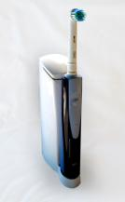
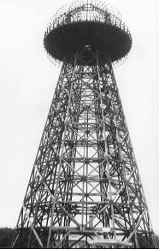
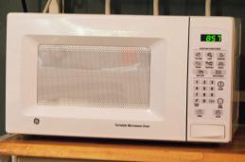
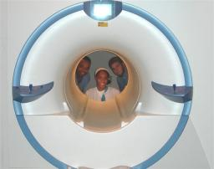
Examples of the Wireless Energy Transfer
An electric toothbrush uses traditional magnetic induction to recharge its batteries, avoiding the need for exposed electrical contacts.
Nikola Tesla’s Wardenclyffe tower built on Long Island, NY in 1904. This tower was intended to implement Tesla’s vision of transmitting power and information around the world. The tower was destroyed in 1917.
A microwave oven utilizes microwave radiation to cook food.
On June 5, 1975
NASA JPL Goldstone demonstrated directed radiative microwave power transmission successfully transferring 34kW of electrical power over a distance of 1.5km at 82% efficiency.
MRI machines use “magnetic resonance imaging” to produce diagnostic images of soft tissue.
All images are in the public domain.

Slide 15
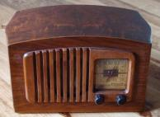
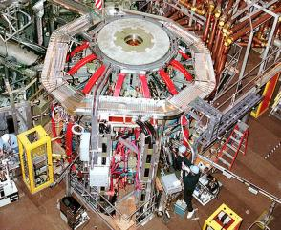

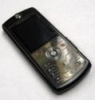
Wireless Energy Transfer
30kHz
300MHz
300GHz
Radio Waves
100kHz
-100MHz
Microwaves
800MHz
-2GHz
2.45GHz
110-140GHz
Radio
Wi-Fi
Microwave oven
Tokamak
Tokamak image by Sheliak (Princeton Plasma Physics Laboratory) <http://commons.wikimedia.org/wiki/File:NSTX.jpg> on Wikimedia, radio, TV and cellphone images are in the public domain

Slide 16
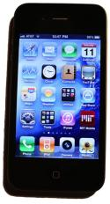
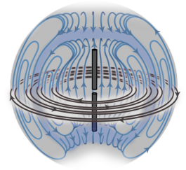
Cell Phones
30kHz
300MHz
300GHz
Radio Waves
Microwaves
800MHz
-2GHz
Current / Planned Technologies | Band | Frequency (MHz)
SMR iDEN | 800 | 806-824 and 851-869
AMPS, GSM, IS-95 (CDMA), IS-136 (D-AMPS), 3G | Cellular | 824-849 and 869-894
GSM, IS-95 (CDMA), IS-136 (D-AMPS), 3G | PCS | 1850–1915 and 1930–1995
3G, 4G, MediaFlo, DVB-H | 700 MHz | 698-806
Unknown | 1.4 GHz | 1392–1395 and 1432–1435
3G, 4G | AWS | 1710–1755 and 2110–2155
4G | BRS/EBS | 2496–2690
Table from http://en.wikipedia.org/wiki/Cellular_frequencies

Slide 17
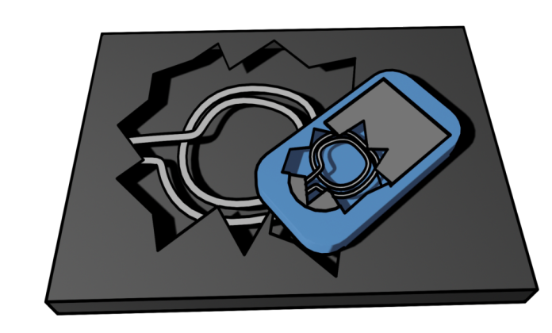
Inductive Charging
Primary
coil
Secondary
coil

Slide 18







Magnetic Field in a Uniform Electromagnetic Plane Wave
In free space …
… where

Slide 19


Uniform Electromagnetic Plane Waves In Materials
Inside a material …
… where
is known as the phase velocity

Slide 20
Index of Refraction
Material
Vacuum | 1
Air | 1.000277
Water liquid | 1.3330
Water ice | 1.31
Diamond | 2.419
Silicon | 3.96
frequency
wavelength
When propagating in a material,
at 5 x 10¹⁴ Hz
λ (m)
10²
10⁻¹
10⁻³
10⁻⁴
10⁻⁵
10⁻⁶
10⁻⁷
10⁻⁸
10⁻⁹
10⁻¹⁰
10⁻¹¹
10⁻¹²
10³
10¹
1
10⁻²
Radio waves
“Hard” X-rays
Microwaves
IR
UV
“Soft” X-rays
Gamma rays
Visible

Slide 21
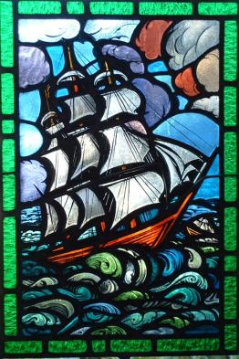
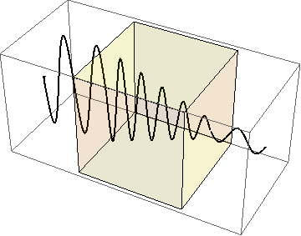
Absorption
check
Photograph by Hey Paul on Flickr.
Why are these stained glasses
different colors?
Tomorrow: lump refractive index and absorption into a complex refractive index
Absorption
coefficient
Refractive
index

Slide 22
Key Takeaways
Propagation velocity
Direction of propagation given by
Energy stored in electric field per unit volume at any instant at any point is equal to energy stored in magnetic field
Instantaneous value of the Poynting vector given by
When propagating in a material,
Antennas use time-varying current to send EM waves. Antennas receive EM waves because oscillating fields produce time-varying current.
Absorption
coefficient
Refractive
index

Slide 23
MIT OpenCourseWare
http://ocw.mit.edu
6.007 Electromagnetic Energy: From Motors to Lasers
Spring 2011
For information about citing these materials or our Terms of Use, visit: http://ocw.mit.edu/terms.

